Slide 1
Anna KUZNETSOVA-WERLE, Lawyer
DG1 - Department of the European Social Charter
SEPTEMBER 2017
The European Social Charter and persons with disabilities

Slide 2
European Social Charter
What is the European Social Charter?
Council of Europe treaty
Social constitution of Europe
Guarantees fundamental social and economical rights
« Human rights in everyday’s life »
Specific protection of vulnerable persons without discrimination
Dignity, equality, solidarity

Slide 3
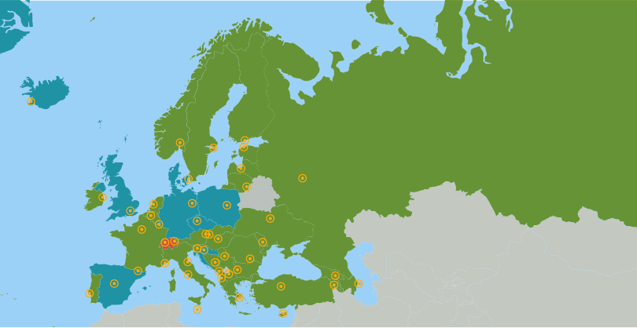
European Social Charter
43 member states

Slide 4
Which obligations for the States?
Minimum 16/31 Articles
or 63/98 paragraphs,
including 6/9 “hard core” Articles :
1 right to work
5 right to organise
6 right to bargain collectively
7 protection of children and young persons
12 social security
13 social and medical assistance
16 protection of the family
19 protection of migrant workers
20 equal opportunities

Slide 5
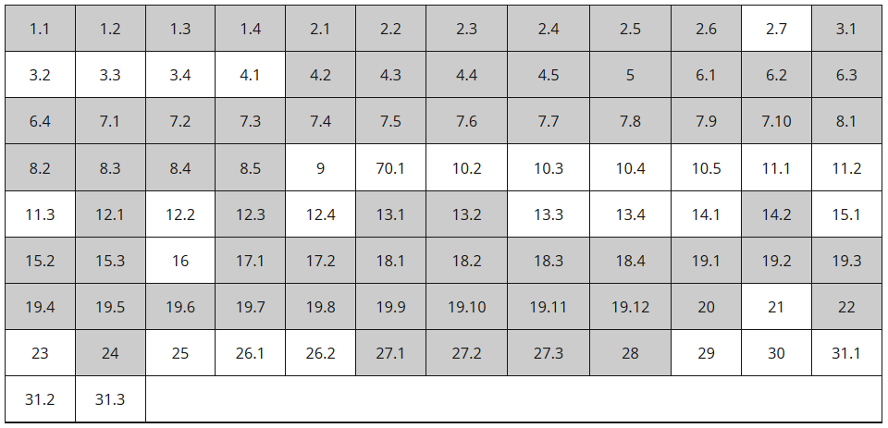
Armenia and the European Social Charter

Slide 6
Article E – Non-discrimination
“The enjoyment of the rights set forth in this Charter shall be secured without discrimination on any ground such as race, colour, sex, language, religion, political or other opinion, national extraction or social origin, health, association with a national minority, birth or other status.”

Slide 7
Article 15 of the European Social Charter
The right of persons with disabilities to independence, social integration and participation in the life of the community
With a view to ensuring to persons with disabilities, irrespective of age and the nature and origin of their disabilities, the effective exercise of the right to independence, social integration and participation in the life of the community, the Parties undertake, in particular:
to take the necessary measures to provide persons with disabilities with guidance, education and vocational training in the framework of general schemes wherever possible or, where this is not possible, through specialised bodies, public or private;
to promote their access to employment through all measures tending to encourage employers to hire and keep in employment persons with disabilities in the ordinary working environment and to adjust the working conditions to the needs of the disabled or, where this is not possible by reason of the disability, by arranging for or creating sheltered employment according to the level of disability. In certain cases, such measures may require recourse to specialised placement and support services;
to promote their full social integration and participation in the life of the community in particular through measures, including technical aids, aiming to overcome barriers to communication and mobility and enabling access to transport, housing, cultural activities and leisure.

Slide 8
Article 15 of the European Social Charter
The right of persons with disabilities to independence, social integration and participation in the life of the community
With a view to ensuring to persons with disabilities, irrespective of age and the nature and origin of their disabilities, the effective exercise of the right to independence, social integration and participation in the life of the community, the Parties undertake, in particular:
to take the necessary measures to provide persons with disabilities with guidance, education and vocational training in the framework of general schemes wherever possible or, where this is not possible, through specialised bodies, public or private;
to promote their access to employment through all measures tending to encourage employers to hire and keep in employment persons with disabilities in the ordinary working environment and to adjust the working conditions to the needs of the disabled or, where this is not possible by reason of the disability, by arranging for or creating sheltered employment according to the level of disability. In certain cases, such measures may require recourse to specialised placement and support services;
to promote their full social integration and participation in the life of the community in particular through measures, including technical aids, aiming to overcome barriers to communication and mobility and enabling access to transport, housing, cultural activities and leisure.

Slide 9
Key figures taken into consideration:
15§1
Total number of persons with disabilities, including the number of children;
Number of students with disabilities following respectively mainstream and special education and vocational facilities;
The percentage of students with disabilities entering the labour market following mainstream or special education or/and training;
The number of persons with disabilities (children and adults) living in institutions;
Any relevant case law and complaints brought to the appropriate bodies with respect to discrimination on the ground of disability in relation to education and training.

Slide 10
Article 15 of the European Social Charter
The right of persons with disabilities to independence, social integration and participation in the life of the community
With a view to ensuring to persons with disabilities, irrespective of age and the nature and origin of their disabilities, the effective exercise of the right to independence, social integration and participation in the life of the community, the Parties undertake, in particular:
to take the necessary measures to provide persons with disabilities with guidance, education and vocational training in the framework of general schemes wherever possible or, where this is not possible, through specialised bodies, public or private;
to promote their access to employment through all measures tending to encourage employers to hire and keep in employment persons with disabilities in the ordinary working environment and to adjust the working conditions to the needs of the disabled or, where this is not possible by reason of the disability, by arranging for or creating sheltered employment according to the level of disability. In certain cases, such measures may require recourse to specialised placement and support services;
to promote their full social integration and participation in the life of the community in particular through measures, including technical aids, aiming to overcome barriers to communication and mobility and enabling access to transport, housing, cultural activities and leisure.

Slide 11
Key information taken into consideration:
15§2
No. of people with disabilities
No. of people with disabilities of working age
No. of people with disabilities employed (open market and sheltered employment)
No. of people with disabilities benefiting from employment promotion measures
No. of people with disabilities seeking employment / unemployed
Non-discrimination legislation
Measures to promote employment

Slide 12
Article 15 of the European Social Charter
The right of persons with disabilities to independence, social integration and participation in the life of the community
With a view to ensuring to persons with disabilities, irrespective of age and the nature and origin of their disabilities, the effective exercise of the right to independence, social integration and participation in the life of the community, the Parties undertake, in particular:
to take the necessary measures to provide persons with disabilities with guidance, education and vocational training in the framework of general schemes wherever possible or, where this is not possible, through specialised bodies, public or private;
to promote their access to employment through all measures tending to encourage employers to hire and keep in employment persons with disabilities in the ordinary working environment and to adjust the working conditions to the needs of the disabled or, where this is not possible by reason of the disability, by arranging for or creating sheltered employment according to the level of disability. In certain cases, such measures may require recourse to specialised placement and support services;
to promote their full social integration and participation in the life of the community in particular through measures, including technical aids, aiming to overcome barriers to communication and mobility and enabling access to transport, housing, cultural activities and leisure.

Slide 13
Key information taken into consideration:
15§3
Anti-discrimination legislation and integrated approach
Consultation
Forms of financial aid to increase the autonomy of persons with disabilities
Measures to overcome obstacles
Technical aids
Communication (including the new information technology and by giving official status to sign language)
Mobility and transport (land, rail, sea and air)
Housing (public, social and private, whether they’re newly built or renovated)
Culture and leisure (social and sporting activities)

Slide 14
The main rights guaranteed by the Revised Social Charter, which also apply to persons with disabilities
Persons with Disabilities
Housing
Health
Social protection
Employment
Integration and participation
Non-Discrimination
Education

Slide 15
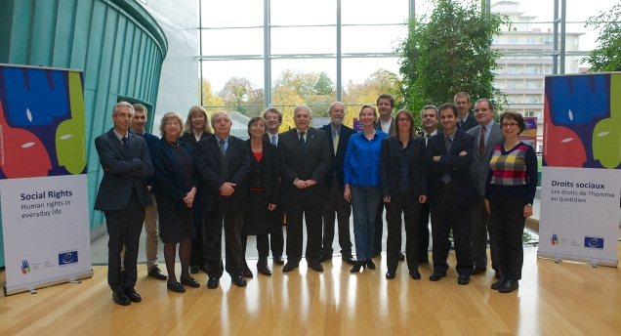
The European Committee of Social Rights (ECSR)
A committee of 15 independent and impartial experts acting in their individual capacity
Chosen by the Committee of Ministers for a period of six years, renewable once
7 one-week sessions
per year

Slide 16
The European Committee of Social Rights (ECSR)
Makes a legal assessment of the conformity of national situations in the States parties with the Charter
Has exclusive competence to interpret the Charter
Two monitoring mechanisms: periodic reporting and collective complaints.

Slide 17
The Collective Complaints Procedure

Slide 18
The collective complaints procedure
A procedure for examining alleged violations of the Charter
A collective complaint is lodged by an organisation – collective in nature
An alleged violation of one or more of the provisions accepted by the state party
Between 1998 and mid-2017, 151 complaints have been introduced

Slide 19
Collective complaints PROCEDURE
Collective complaint must necessarily be lodge against a State in which the Charter is in force and which has accepted the system of collective complains.
Belgium
Finland
Ireland
Portugal
Bulgaria
France
Italy
Slovenia
Croatia
Cyprus
Greece
Norway
Sweden
The Czech Republic
The Netherlands

Slide 20
Monitoring based on Collective Complaints
European Social Charter
Collective complaints
Judicial Assessment
Complaints lodged by trade unions,
Employers’ organisations and NGOs
alleging violations of the Charter
European Committee of Social Rights (ECSR)
decides whether the complaints are
admissible and well-founded
Follow-up
Committee of Ministers
verifies that the States bring the situation into conformity with the Charter.
If not, it addresses a Recommendation

Slide 21
Mental Disability Advocacy Center (MDAC) v. Bulgaria (No. 41/2007)
the number of children with special educational requirements receiving education in mainstream kindergartens and in general education schools increased by 31.9 % between 2008 and 2010 ;
the number of kindergartens and schools in the country, where children and pupils with special educational requirements are being taught increased by 6.8%;
the specialized personnel working there increased by 16.5%,
500 new pedagogues working with children with disabilities in the general education environment have been trained in 2009 (against 400 in 2008) ;
a special expert commission has been set up which ensures the evaluation and guidance of children and pupils with special educational needs;
a national strategy was launched with the aim of preventing the institutionalisation of children with disabilities.
The implementation of these measures is being followed-up in the framework of the reporting procedure (the next assessment will take place in 2018).

Slide 22
The Reporting Mechanism
Periodic reporting by states parties

Slide 23
Thematic Reports
European Social Charter
National Reports
Group 1 Employment, training and equal opportunities - Article 1 - Article 9 - Article 10 - Article 15 - Article 18 - Article 20 - Article 24 - Article 25 | Group 2 Health, social security and social protection - Article 3 - Article 11 - Article 12 - Article 13 - Article 14 - Article 23 - Article 30 | Group 3 Labour rights - Article 2 - Article 4 - Article 5 - Article 6 - Article 21 - Article 22 - Article 26 - Article 28 - Article 29 | Group 4 Children, families, migrants - Article 7 - Article 8 - Article 16 - Article 17 - Article 19 - Article 27 - Article 31
Annual reports transmitted by 31 October
Committee’s conclusions issued at the beginning of the following year
As from 2014, a simplified monitoring procedure (report every 2 years) applies to States which have accepted the Collective complaints procedure

Slide 24
What the national reports contain?
1) the legal framework – description of the laws or regulations, collective agreements or other provisions that contribute to the application of the Charter nationally; as well as any relevant national case-law decisions by courts and other judicial bodies
2) description of the measures taken to implement the legal framework (administrative arrangements, programmes, action plans, projects, etc.)
3) figures, statistics or any other relevant information enabling an evaluation of the extent to which these provisions are applied in practice

Slide 25
Monitoring procedure based on periodic reports
Governments report to the European Committee of Social Rights on the implementation of the Charter provisions accepted by them
The reports are sent to representative national trade unions and employer’s organisations, who may submit their comments on the Government’s report directly to the Committee
A report is submitted annually by each state on provisions belonging to one thematic group

Slide 26
Monitoring based on National Reports
European Social Charter
National Reports
Judicial assessment
National Reports
on the implementation of the Charter
Comments from
Social Partners and NGOs
European Committee of Social Rights (ECSR)
Determines whether the national situation
(law and practice) is in conformity with the Charter
= adopts conclusions for each State
Follow-up
Governmental Committee
prepares the work of the Committee of Ministers
Committee of Ministers
addresses Recommendations asking States
to bring national law and practice into conformity

Slide 27
National reports
All national reports are available on the Charter’s internet page
The Committee’s conclusions are published on the internet page after their adoption
In its conclusions, the Committee may put questions to the state for the purpose of the evaluation during the next cycle

Slide 28
Impact of the Charter on the rights of persons with disabilities
Romania amended its definition of disability in 2010 to bring it in line with the 2001 International Classification of Functioning and Health definition endorsed by the WHO ; Spain also reformed its legislation on disability, including the definition of disability in 2011 and the Republic of Moldova in 2012;
In Georgia, a Law on the Elimination of All Forms of Discrimination entered into force in 2014, which prohibits all discrimination, both direct and indirect and also introduces the notion of positive action in certain specific cases involving, inter alia, disability;
In the Russian Federation, following a judgment of 2009 by the Constitutional Court and the adoption of a new law in 2011, persons with mental disorders and deprived of legal capacity gained the right to refuse a medical treatment and to contest their legal capacity status before the courts.
Several states adopted legislation prohibiting discrimination on ground of disability in the field of education, for example Italy in 2006, Estonia and Norway in 2009, Ukraine in 2012, the Republic of Moldova in 2013; other states have reviewed and updated their relevant legislation;
The employer’s obligation to provide for reasonable accommodation for persons with disabilities was introduced in 2008 in Lithuania, in 2009 in Portugal, in 2010 in Poland, in 2013 in Italy ;
In the Russian Federation, quotas for the employment of persons with disabilities have been extended to small and medium-sized enterprises in 2013.

Slide 29
THANK YOU FOR YOUR ATTENTION !
Questions or feedback ?
Please
do not hesitate to contact us at
social.charter@coe.int
Department of the European Social Charter
Directorate General Human Rights
and Rule of Law
Council of Europe
F – 67075 Strasbourg Cedex

